Slide 1
ISCG7427 Agile and Lean Software Delivery
Topic 2 - Agile Teams Work
Environment, and Scrum Overview

Slide 2
Organising Agile teams
What is project success?
When all stakeholder’s objectives are met.
Who is responsible for project success?
The entire team; no individual is responsible for the success or failure of an Agile project.

Slide 3
Organising Agile teams
What is project success?
When all stakeholder’s objectives are met.
Who is responsible for project success?
The entire team; no individual is responsible for the success or failure of an Agile project.

Slide 4
Organising Agile teams
The quality of your teamwork will impact team performance.
Read http://web.mit.edu/jrankin/www/teamwork/quality_evidence_Hoegl.pdf
Discuss:
What's the implication to your attitude and behaviour in group assignments (and in Agile teams)?

Slide 5
Cross-functional Team
Fewer narrowly focused specialists
More “generalising specialists”
Multi-disciplinary or cross-functional developers who possess
One or more technical specialities
General knowledge of software or systems development
General knowledge of the business domain
Actively seek to gain new skills

Slide 6
Advantages of having a cross-functional team
Improved communication and collaboration
Less internal project documentation
Improved flexibility
Less project risk as you’re not reliant on specific individuals

Slide 7
Self organisation
The people who do the work are best suited to organize how they’re going to do the work
Command and control approach:
A manager assigns work to people
Self organizing approach:
The team is responsible for self-management
The team estimates the size and complexity of the work
The team determines the technical solution
The team commits to the work they can do in a time box
The team is responsible for project delivery
The team is continuously committed to finding ways improve

Slide 8
Agile team
An Agile team does not differentiate between traditional roles such as "developer", "analyst" and "tester". Since the entire team is accountable for outcome, everyone in the project will do what is needed to complete the project. For example, a developer can perform activities at various times such as clarify needs with stakeholders, write code, and tests code. This is not to say they do not have their primary expertise - a lot of them do. But they should not be constrained to their primary role, but should be cross trained to perform different tasks in an agile project.
The team should be cross-functional, which includes the capability to perform all tasks needed to complete the agile project. It includes both technical capabilities (setup infrastructure, design, code, test) and business capabilities (domain knowledge, decision making).

Slide 9
Exercise - Command and Control
Pair up with another student; try to choose someone you don’t know
One person takes on the role of the “Manager”; the second takes on the role of the “Developer”
Rules:
Everyone, including“Manager”, must stay within the taped-off area during the exercise
The “Manager”can give three commands to the “Developer”:
Take a step,
Turn left,
Turn right
The “Developer”: must do exactly what the manager says
You have two minutes to take 100 steps/or reach other end of marked area
(lecturer will announce time)
You need to go around obstacles ( chairs, other people), if you crash step back 5 steps

Slide 10
Command and Control vs Exercise - Self organisation
Discussion

Slide 11
Agile Team Roles
Core Roles:
Team Lead
Product Owner
Agile Team Member
Additional Roles:
Architecture Owner
Domain Expert
Technical Expert
Independent Tester
Integrator
Specialist

Slide 12
Stakeholders

Slide 13
Stakeholders
Stakeholders are the people who have an interest in the project. They will affect a project and/or be affected by the project in some way, shape or form.
Stakeholders typically include:
End users
Business managers
Project sponsors
Operations staff
Support staff
Consultants
Development team (in this context, we excluded agile development team as agile roles are discussed as separate items)
Stakeholders often have conflicting views of what a system should do.

Slide 14
Team Lead
Team Leads are responsible for ensuring the Agile process is followed.
Also called a Team Coach or Scrum Master
At project initiation
Establishes the right team and Product Owner
Facilitates creation and evolution of the work item list
Facilitates creation and evolution of a release plan
Facilitates iteration planning
Daily
Conducts Daily Stand-Up Meetings
Remove Impediments
Gauge progress
Steer the team
Plans and conducts iteration review

Slide 15
Product Owner
Product Owner defines and promotes the vision, goals, and capabilities of the product so team can make decisions
Ultimately responsible for the value of the end product
Owns the Product Backlog/Work Item List and defines acceptance criteria for work items
Determines the scope/content of the release (release planning)
Defines acceptance criteria for the release and determines when the system is ready for release
Existing Business Analysts often transition into this role

Slide 16
Agile Team Member
Agile Team Member is everyone else on the team
Often referred to as “developer”
Cross-functional, collaborative, self-managed
Mandatory participation in the Daily Stand-Up Meeting
Provides “relative size” estimates for items in the product backlog
Actively involved with iteration planning
Maintain the iteration backlog and/or taskboard
Update “work remaining” estimates daily

Slide 17
Architecture Owner
Architecture Owner is responsible for the architecture of the system or subsystems that the team is working on
Mentors and guides the developers in architectural issues, and leads them through technical issues
Understands the architectural direction and standards of their organization and helps to ensure that the team adheres to them appropriately
Technical leader of the team and has the final say regarding technical decisions

Slide 18
Other Roles
Domain Expert - has detailed knowledge about one or more aspects of the problem domain
Technical Expert - has detailed technical knowledge needed
Independent Tester - Focuses on complex testing efforts, working parallel but independent of the team.
Integrator - Responsible for building the entire system from its various subsystems
Specialist - Sometimes component sub teams require people focused on narrow specialties

Slide 19
Exercise - self-forming a cross-functional team
Objective: experience self-forming a cross-functional team
Step 1: Write down what skills you think are needed within a team to successfully complete an agile project (5 mins)
Step 2: Write down what skills you have (5 mins)
Step 3: Class Discussion - what did you write down? (led by instructor, 5 mins)
Step 4: Share with other members of your group – does the group have all the skills required for completing your assignment? (5 mins)
Step 5: Identify gaps (led by instructor) (5 mins)

Slide 20
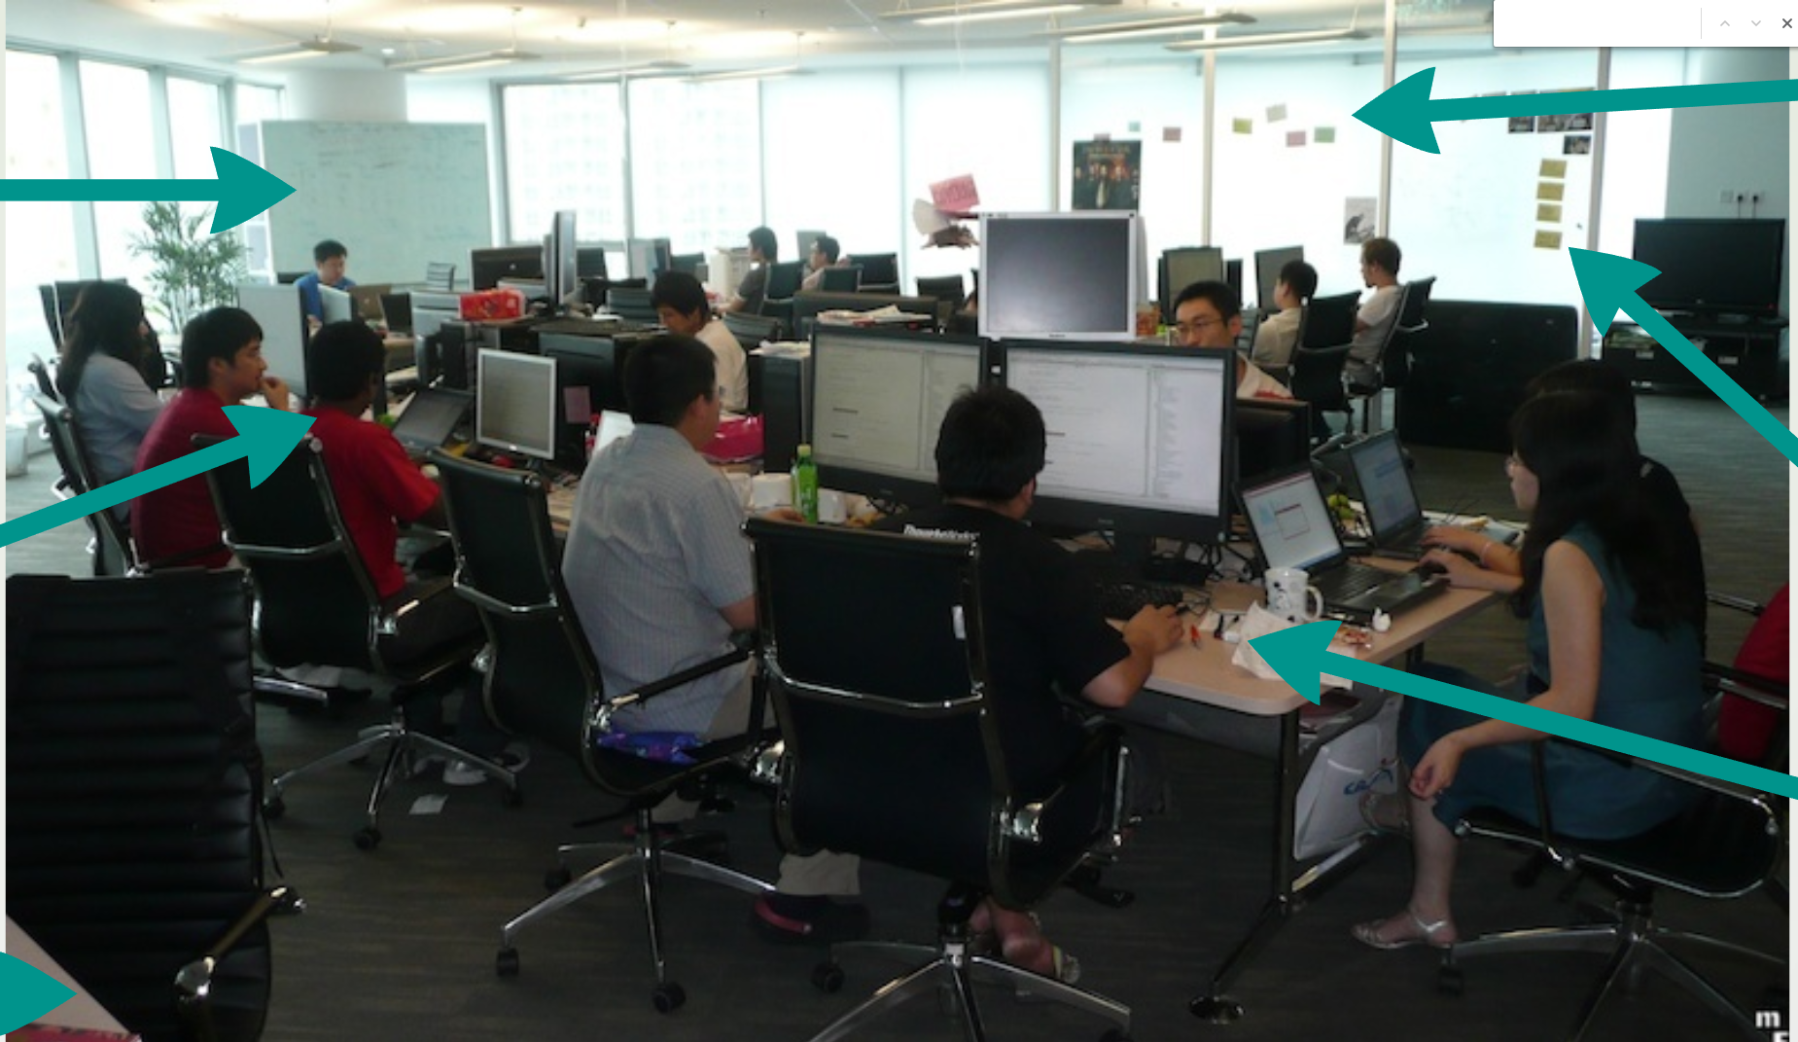
Agile Work Environment
Whiteboards for tacking up index cards and other paper
Lots of post-it notes
Open area desk setup to promote communication, flexibility, and visibility
Lots of whiteboard space for model storming and planning
Ideally all core team members in the same room
Shared work table space for modelling and planning
Why do it?
Removes distractions and increases focus on business mission
Reduces communications and interactions to minutes
Speeds decision-making, issue resolution, product development
Increases clarity and understanding and reduces surprises
Fosters teaming, e.g., creativity, collaboration, collective ownership, motivation, trust, respect, achievement

Slide 21
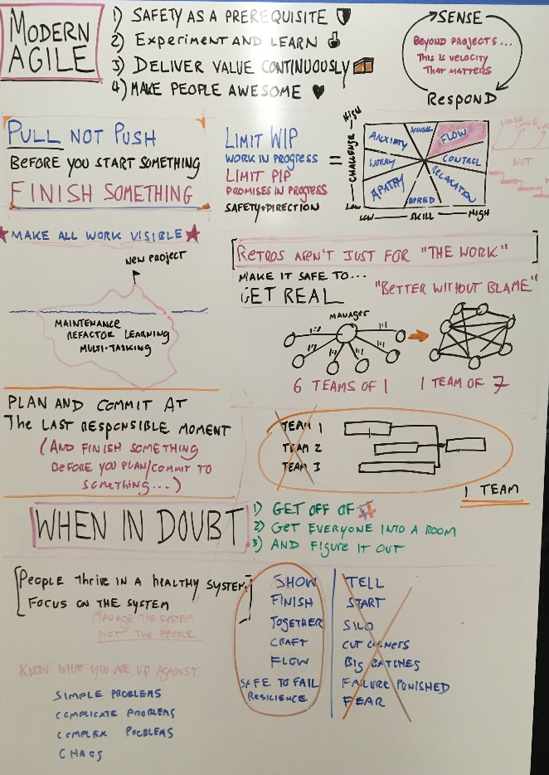

Agile work environment facilitated sharing of tack
Tactic Knowledge
Overheard
Corridor chats
Pair programming
Documented Knowledge
Formal
Not complete

Slide 22
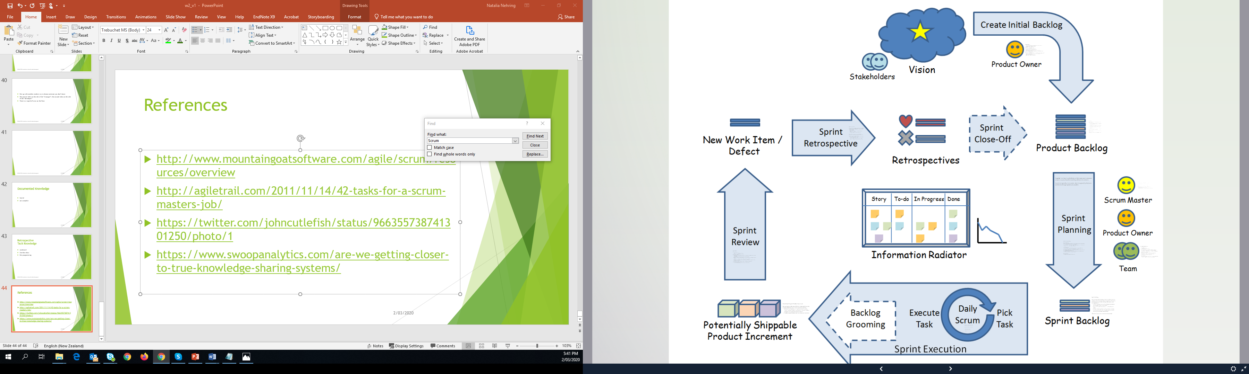
Scrum
Scrum is an agile process most commonly used for product development, especially software development.
Scrum is a project management framework that is applicable to any project with aggressive deadlines, complex requirements and a degree of uniqueness.
(http://www.mountaingoatsoftware.com/agile/scrum/overview, reproduced with permission from Mountain Goat Software)

Slide 23
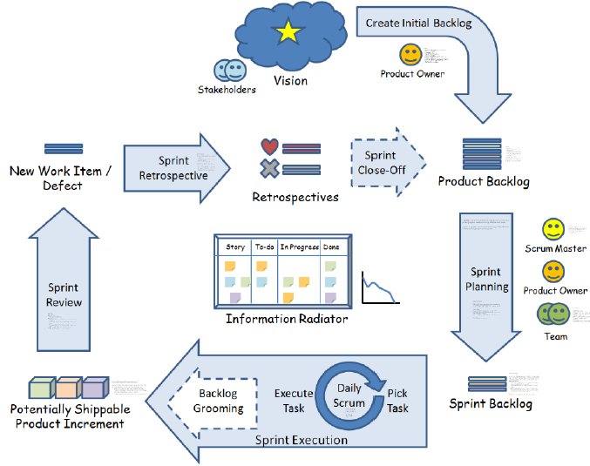
Scrum

Slide 24
As a Scrum Master, you
Serve as the keeper of the scrum process, “holding space” for the team.
Provide facilitation for team meetings during the sprint - this can mean leading them yourself, recruiting an outside facilitator, or helping the team facilitate their own meetings.
Know when to step back and let the team learn through their own experience, including mistakes.
Are available to the team and the product owner to answer questions and give advice.
Protect the team from outside distractions, serving as a buffer between the team and external stakeholders.
Remove impediments for the team, so they can get on with the work.
Are not the boss. Your role is defined by a unique set of responsibilities, not by rank.
Help the team master the use of scrum artefacts, like the task board, the sprint backlog, and burn charts.
Coach the Product Owner and individual team members, in scrum practices.
Act as your organisation’s chief scrum evangelist, helping the entire company embrace scrum.
Lead the daily scrum until the team members are comfortable running it by themselves.
Run the second half of the story time meeting, or assist the team members in running it themselves.
Provide facilitation for, and participate in, the sprint retrospective.
Are not the scrum police!
Ensure that your duties as a technical contributor - if you are one—do not detract from your role as scrum master.

Slide 25
As a Team Member, you…
Provide Estimates
Clarify user needs (stories)
Commit to work on items from the sprint backlog
Do the work of delivering a potentially releasable Increment of “Done” product at the end of each Sprint
Share your knowledge
Report your progress in daily stand up meetings
Demonstrate your work in a Sprint Review
Contribute to Sprint Retrospective
self-organise
are accountable as a team, there is no recongised title of "tester", "analyst", everyone is a "developer"

Slide 26
As a Product Owner, you…
Hold the vision for the product on behalf of the business, the customer, and the user.
Represent the interests of the business to the team.
Represent the product and the team to the business.
Communicate with stakeholders regularly.
Do not hold the role of scrum master
Write user stories and help others write user stories.
Understand the business value of each user story.
Prioritize the user stories into a strictly ordered backlog.
Identify acceptance criteria for each story.
Collaborate with the rest of the team to create the team’s definition of done.
Accept or reject completed work, determining whether it has met the acceptance criteria.
Arbitrate conflicting requirements from stakeholders.
Do not tell the team how to do the work
Do not estimate stories – but provide the information that the team needs to estimate each story.
Make yourself available to answer the team’s questions about requirements and business value.
Make the call in the rare instances when a sprint needs to be terminated early.
Clarify requirements for the team.
Lead the first part of the sprint planning meeting.
Gather feedback from stakeholders at the sprint review.

Slide 27
Product Backlog
An ordered features list, containing short descriptions of all functionality desired in the product
Typically lists features, functions, requirements, enhancements, and fixes that are desired in the product. Technical work and knowledge acquisition also belong in the product backlog
Product Owner is responsible for Product Backlog, including its content, availability and ordering
Typically, a Scrum team and its product owner begin by writing down everything they can think of easily. This is almost always more than enough for a first sprint.
The Product Backlog evolves (allowed to grow and change) as more is learned about the product and its customers.
Multiple Scrum teams often work on the same Product Backlog; an attribute is used to group items

Slide 28
Product Backlog (continue)
It is ALL the things need/want to be done. If a thing is in there, it might get done. If it isn’t there, there is no chance that it will be done.
It’s a list of ‘want to do’, and not a commitment. Items can be estimated (preferable) or not, but neither case implies a specific time commitment as to when any of it will be done.
It has a single owner – the Product Owner. This protects the team from the problem of multiple stakeholders, each with potentially divergent views of what’s important.

Slide 29
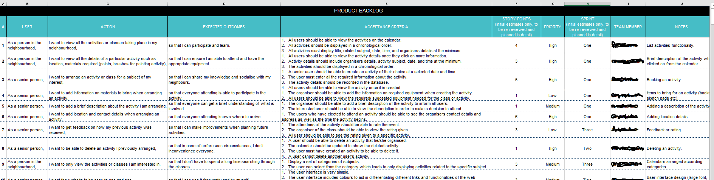
Example of Initial Backlog
Backlog – set of User stories, with setting of priorities
Each story must include 3 main components plus Estimation:
Description (Who, What & Why)
Acceptance Criteria (Given…(context) When…(event) Then…(outcome))
Supporting Models (for example wireframe(s), ERD, workflow, other diagrams)
Estimation in points, or Size (depends on method used)
This is example from one of student’s team, here we missing colon with reference to supporting materials

Slide 30
Exercise – Product Backlog
Objective: state project requirements, as many as you can
(20 mins)
ABC Kindergarten wants to have a new online system in order to provide better quality services to the users including kindergarten manager, teachers, parents and children by improving communication between teachers and parents, simplifying everyday performance of the kindergarten, enhancing security and safety, and entertaining the children.
The interaction and collaboration between teachers and parents is very important to establish a positive and good early education environment for children. With the development of the Internet, most kindergartens also have built their own websites, which provide more communication methods and communication channels for both parties. Parents can get their children's information, activities, performance and security situation anytime, anywhere.
Children can play online education games, suitable for their age
Present it
User Story format:
As a [role] I want to [feature] so that I can [reason]
Example: As a parent I want to receive my child’s daily story so that I can be informed about my child day activities

Slide 31
A sprint
A sprint is a time-boxed milestone that teams use to measure project progress, based on working software increments.
A sprint is typically 2 to 4 weeks. But it is agreed by the team and shorter/longer sprints are possible.

Slide 32
There are four (events) ceremonies in Scrum
Sprint Planning
Daily Scrum
Sprint Review
Sprint Retrospective
https://www.scrumalliance.org/

Slide 33
Sprint Planning Meeting
Before the Meeting
Product Owner develops the Vision and translates it into the Product Backlog
The Product Owner orders the Product Backlog
The Development Team with the support of the Product Owner estimates the relative size of the each product backlog item
During the Meeting
The Development Team determines its available capacity and Velocity
(velocity = number of points completed in previous sprint)
The Agile Team collaborates on the development of a plan for the work to be performed during the upcoming Sprint
The Agile Team estimates the points per user story, and breaks down user stories into smaller tasks with effort estimates
After the Meeting
The Agile team begins work on the Sprint

Slide 34
Sprint Backlog
Set of Product Backlog items selected for the Sprint, plus a plan for delivering the product increment and meeting the Sprint Goal; provides visibility of the team’s work during the Sprint
Contains enough detail so that changes in progress can be understood in Daily Scrum
Sprint Backlog belongs solely to the Development Team
All Sprint Backlog Items are "owned" by the entire Development Team, even though each one may be done by an individual team member.
The Sprint is over when its time-box has expired

Slide 35
The Daily Scrum
The Daily Scrum is a coordination meeting that fosters communication and collaboration and helps ensure that the entire development team is on the same page.
To achieve this, each team member must report about their work in enough detail to make it transparent to others.
Typically 15 minutes at the same time every workday

Slide 36
The goals of the meeting are to:
Focus the team on the right work
Create a sense of team accountability
Communicate what is going on
Identify issues, risks and dependencies
Support continuous improvement by exposing problems

Slide 37
Potentially Shippable Product Increment
The increment is the sum of all the Product Backlog items completed during a Sprint and all previous Sprints.
At the end of a Sprint, the new increment must be “Done”, which means it must be in a useable condition and meet the teams definition of “Done”.
Product Owner decides when to release an increment

Slide 38
Sprint Review Goal of Sprint Review
Inspect the product increment and
Update the Product Backlog, as needed

Slide 39
During a Sprint Review
Development Team demos the work that it has “done” and answers questions about the increment
Product Owner identifies what has been done/what has not
The likely completion dates are projected by the Product Owner based upon progress to date
Product Owner and Scrum Master update the Product Backlog
Development Team shares what went well, what problems it ran into and how the problems were solved
Entire Scrum Team collaborates on what to do in the upcoming sprint

Slide 40
After the Sprint Review
The Scrum Team gets together for the Sprint Retrospective

Slide 41
The Sprint Retrospective provides a formal opportunity to focus on inspection and adaption.
This is achieved is by asking the team:
What went well?
What could be changed to deliver better results?
What have we learned?
Should we adapt the definition of done?

Slide 42
Sprint Retrospective - Scrum Master’s role
Scrum Master’s role during the retrospective is facilitating and participating as a Scrum Team Member
By the end of the Sprint Retrospective
Scrum Team should have identified improvements that will be made in the next Sprint
Implement improvements in the next Sprint is the adaption and inspection of Scrum (process) itself

Slide 43
Retrospective
Tell me (at least) one idea you learnt today
How can you apply what you learnt outside of the class?
Is there anything you are not clear about today's topic?
Is there anything we did that you would like changed?

Slide 44
References
http://www.mountaingoatsoftware.com/agile/scrum/resources/overview
http://agiletrail.com/2011/11/14/42-tasks-for-a-scrum-masters-job/
https://twitter.com/johncutlefish/status/966355738741301250/photo/1
https://www.swoopanalytics.com/are-we-getting-closer-to-true-knowledge-sharing-systems/
https://prezi.com/jbp8bzqpwt4x/?token=d9a4a96b90dca420bab06a5663b171eef80e460bb401f17a368e700db64f3ec3&utm_campaign=share&utm_medium=copy

